Slide 1
Algorithm Analysis and Design Advanced Data Structure (Red Black Tree) (Properties, Rotation and Insertion)
Lecture -26-28

Slide 2
Overview
A variation of binary search trees.
Balanced: height is O(lg n), where n is the number of nodes.
Operations will take O(lg n) time in the worst case.

Slide 3
Red Black Tree
A red-black tree is a binary search tree + 1 bit per node: an attribute color, which is either red or black.
All leaves are empty (nil) and colored black.
A single sentinel, nil[T ], is used for all the leaves of red-black tree T .
Color of [nil[T ]] is black.
The root′s parent is also nil[T ].
All other attributes of binary search trees are inherited by red-black trees (i.e. key, left, right, and p as parent).
We don′t care about the key in nil[T ].

Slide 4
Red Black Tree
Properties:
Every node is either red or black.
The root is always black.
Every leaf (nil[T]) is black.
If a node is red, then both its children are black. (Hence no two reds in a row on a simple path from the root to a leaf is allowed .)
For each node, all paths from the node to descendant leaves contain the same number of black nodes.

Slide 5
Red Black Tree
Height of a red-black tree
Height of a node is the number of edges in a longest path to a leaf.
Black-height of a node x: bh(x) is the number of black nodes (including nil[T ]) on the path from x to leaf, not counting x. By property 5, black-height is well defined.
h=4
bh=2
26
h=3
bh=2
h=1
bh=1
17
41
h=2
bh=1
h=2
bh=1
30
47
h=1
bh=1
h=1
bh=1
38
50
NIL

Slide 6
Red Black Tree
Rotations
The basic tree-restructuring operation.
Needed to maintain red-black trees as balanced binary search trees.
Changes the local pointer structure. (Only pointers are changed.)
Won′t upset the binary-search-tree property.
Have both left rotation and right rotation. They are inverses of each other.
A rotation takes a red-black-tree and a node within the tree.

Slide 7
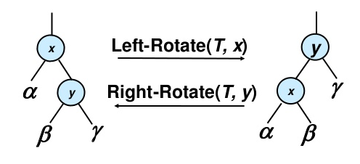
Red Black Tree
Rotations

Slide 8
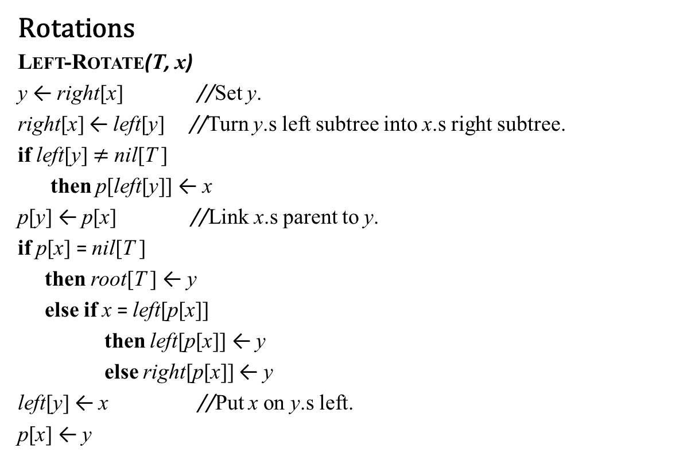
Red Black Tree
Rotations
Left-Rotate(T, x)
y ← right[x] //Set y.
right[x] ← left[y] //Turn y.s left subtree into x.s right subtree.
if left[y] $≠$ nil[T ]
then p[left[y]] ← x
p[y] ← p[x] //Link x.s parent to y.
if p[x] = nil[T ]
then root[T ] ← y
else if x = left[p[x]]
then left[p[x]] ← y
else right[p[x]] ← y
left[y] ← x //Put x on y.s left.
p[x] ← y

Slide 9
Red Black Tree
Rotations
The pseudocode for LEFT-ROTATE assumes that
right[x] = nil[T ], and
root.s parent is nil[T ].
Pseudocode for RIGHT-ROTATE is symmetric: exchange left and right everywhere.

Slide 10
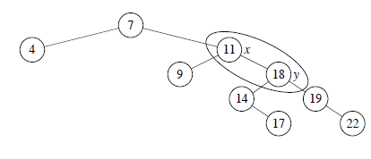
Red Black Tree
Rotations (Example)
Demonstrate of left rotation that maintains in-order ordering of keys.

Slide 11

Red Black Tree
Rotations (Example)
Demonstrate of left rotation that maintains in-order ordering of keys.

Slide 12
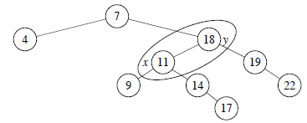
Red Black Tree
Rotations (Example)
Demonstrate of left rotation that maintains in-order ordering of keys.

Slide 13
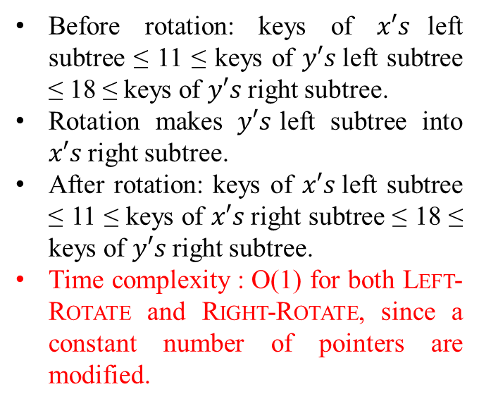
Red Black Tree
Rotations (Example)
Demonstrate of left rotation that maintains in-order ordering of keys.
Before rotation: keys of $x′s$left subtree ≤ 11 ≤ keys of $y′s$left subtree ≤ 18 ≤ keys of $y′s$right subtree.
Rotation makes $y′s$left subtree into $x′s$right subtree.
After rotation: keys of $x′s$left subtree ≤ 11 ≤ keys of $x′s$right subtree ≤ 18 ≤ keys of $y′s$right subtree.
Time complexity : O(1) for both Left-Rotate and Right-Rotate, since a constant number of pointers are modified.

Slide 14
Red Black Tree
Insertion:
Start by doing regular binary-search-tree insertion:

Slide 15
Red Black Tree
Insertion:
RB-Insert(T, z)
y ← nil[T ]
x ← root[T ]
while x = nil[T ]
do y ← x
if key[z] < key[x]
then x ← left[x]
else x ← right[x]
p[z] ← y
if y = nil[T ]
then root[T ] ← z
else if key[z] < key[y]
then left[y] ← z
else right[y] ← z
left[z] ← nil[T ]
right[z] ← nil[T ]
color[z] ← RED
RB-Insert-Fixup(T, z)

Slide 16
Red Black Tree
Insertion:
RB-Insert ends by coloring the new node z red.
Then it calls RB-Insert-Fixup to maintain the properties of a red-black Tree.
Which property might be violated?
1. Every node is either red or black. | OK
2. The root is always black. | If z is the root, then there′s a violation. Otherwise, OK.
3. Every leaf (nil[T]) is black. | OK
4. If a node is red, then both its children are black. | If p[z] is red, there′s a violation: both z and p[z] are red.
5. For each node, all paths from the node to descendant leaves contain the same number of black nodes. | OK

Slide 17
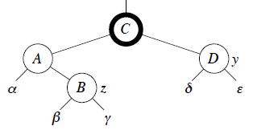
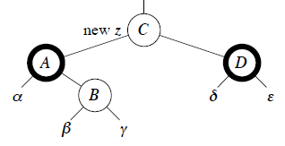

Red Black Tree
Insertion (RB-Insert-Fixup Case 1 (y is red))
[Nodes with bold outline indicate black nodes and light outline indicate red nodes]
if color[y] = RED
then color[p[z]] ← BLACK //Case 1
color[y] ← BLACK //Case 1
color[p[p[z]]] ← RED //Case 1
z ← p[p[z]] //Case 1

Slide 18
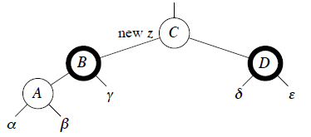
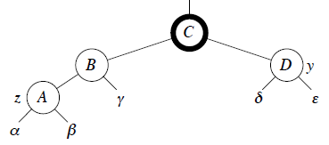
Red Black Tree
Insertion (RB-Insert-Fixup Case 1)
[Nodes with bold outline indicate black nodes and light outline indicate red nodes]
if color[y] = RED
then color[p[z]] ← BLACK //Case 1
color[y] ← BLACK //Case 1
color[p[p[z]]] ← RED //Case 1
z ← p[p[z]] //Case 1

Slide 19
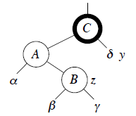
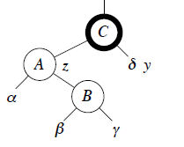
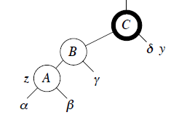
Red Black Tree
Insertion (RB-Insert-Fixup Case 2 (y is black, z is a right child)
[Nodes with bold outline indicate black nodes and light outline indicate red nodes]
if z = right[p[z]]
then z ← p[z] //Case 2
Left-Rotate(T, z) //Case 2

Slide 20
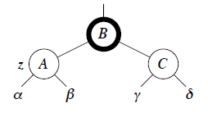
Red Black Tree
Insertion (RB-Insert-Fixup Case 3 (y is black, z is a left child)
[Nodes with bold outline indicate black nodes and light outline indicate red nodes]
color[p[z]] ← BLACK // Case 3
color[p[p[z]]] ← RED // Case 3
Right-Rotate(T, p[p[z]]) // Case 3

Slide 21
Red Black Tree
Insertion:
RB-Insert-Fixup(T, z)
while color[p[z]] = RED
do if p[z] = left[p[p[z]]]
then y ← right[p[p[z]]]
if color[y] = RED
then color[p[z]] ← BLACK //Case 1
color[y] ← BLACK //Case 1
color[p[p[z]]] ← RED //Case 1
z ← p[p[z]] //Case 1
else if z = right[p[z]]
then z ← p[z] //Case 2
Left-Rotate(T, z) //Case 2
color[p[z]] ← BLACK // Case 3
color[p[p[z]]] ← RED // Case 3
Right-Rotate(T, p[p[z]]) // Case 3
else (same as then clause with .right. and .left. exchanged)
color[root[T ]] ← BLACK

Slide 22
Red Black Tree
Insertion (Example):
Insert the following elements into an empty RB-Tree.
[ 11, 2, 14, 1, 7, 15, 5, 8, 4]
Insert -11
11
z

Slide 23
Red Black Tree
Insertion (Example 1):
Insert the following elements into an empty RB-Tree.
[ 11, 2, 14, 1, 7, 15, 5, 8, 4]
Insert -11
11
Apply Fix up
11
z

Slide 24
Red Black Tree
Insertion (Example 1):
Insert the following elements into an empty RB-Tree.
[ 11, 2, 14, 1, 7, 15, 5, 8, 4]
Insert -2
11
No Fixup required
2
z

Slide 25
Red Black Tree
Insertion (Example 1):
Insert the following elements into an empty RB-Tree.
[ 11, 2, 14, 1, 7, 15, 5, 8, 4]
Insert -14
11
2
14
No Fixup required
z

Slide 26
Red Black Tree
Insertion (Example 1):
Insert the following elements into an empty RB-Tree.
[ 11, 2, 14, 1, 7, 15, 5, 8, 4]
Insert -1
11
2
14
z
1

Slide 27
Red Black Tree
Insertion (Example 1):
Insert the following elements into an empty RB-Tree.
[ 11, 2, 14, 1, 7, 15, 5, 8, 4]
Insert -1
11
2
14
z
1

Slide 28
Red Black Tree
Insertion (Example 1):
Insert the following elements into an empty RB-Tree.
[ 11, 2, 14, 1, 7, 15, 5, 8, 4]
Insert -1
11
11
Case 1
Fixup Apply
2
14
2
14
z
z
1
y
1

Slide 29
Red Black Tree
Insertion (Example 1):
Insert the following elements into an empty RB-Tree.
[ 11, 2, 14, 1, 7, 15, 5, 8, 4]
Insert -1
z
z
11
11
11
Case 1
Fixup Apply
2
14
Apply Fix up
2
14
2
14
z
1
y
y
1
1

Slide 30
Red Black Tree
Insertion (Example 1):
Insert the following elements into an empty RB-Tree.
[ 11, 2, 14, 1, 7, 15, 5, 8, 4]
Insert -7
11
2
14
No Fixup required
1
7
z

Slide 31
Red Black Tree
Insertion (Example 1):
Insert the following elements into an empty RB-Tree.
[ 11, 2, 14, 1, 7, 15, 5, 8, 4]
Insert -15
11
2
14
No Fixup required
1
7
15
z

Slide 32
Red Black Tree
Insertion (Example 1):
Insert the following elements into an empty RB-Tree.
[ 11, 2, 14, 1, 7, 15, 5, 8, 4]
Insert -5
11
2
14
1
7
15
5
z

Slide 33
Red Black Tree
Insertion (Example 1):
Insert the following elements into an empty RB-Tree.
[ 11, 2, 14, 1, 7, 15, 5, 8, 4]
Insert -5
11
11
14
Case 1
z
2
14
2
Fixup Apply
15
1
7
15
1
7
5
5
z

Slide 34
Red Black Tree
Insertion (Example 1):
Insert the following elements into an empty RB-Tree.
[ 11, 2, 14, 1, 7, 15, 5, 8, 4]
Insert -8
11
2
14
No Fixup required
1
7
15
5
8
z

Slide 35
Red Black Tree
Insertion (Example 1):
Insert the following elements into an empty RB-Tree.
[ 11, 2, 14, 1, 7, 15, 5, 8, 4]
Insert -4

Slide 36
Red Black Tree
Insertion (Example 1):
Insert the following elements into an empty RB-Tree.
[ 11, 2, 14, 1, 7, 15, 5, 8, 4]
Insert -4

Slide 37
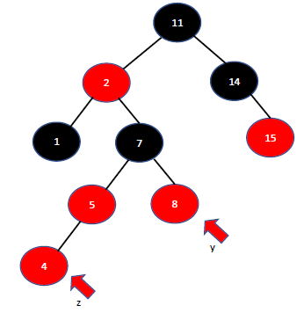
Red Black Tree
Insertion (Example 1):
Insert the following elements into an empty RB-Tree.
[ 11, 2, 14, 1, 7, 15, 5, 8, 4]
Insert -4

Slide 38
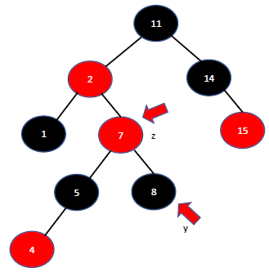
Red Black Tree
Insertion (Example 1):
Insert the following elements into an empty RB-Tree.
[ 11, 2, 14, 1, 7, 15, 5, 8, 4]
Insert -4

Slide 39
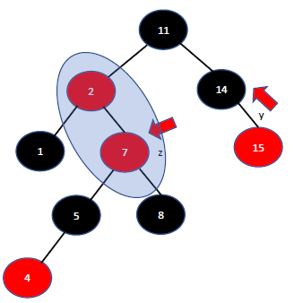
Red Black Tree
Insertion (Example):
Insert the following elements into an empty RB-Tree.
[ 11, 2, 14, 1, 7, 15, 5, 8, 4]
Insert -4

Slide 40
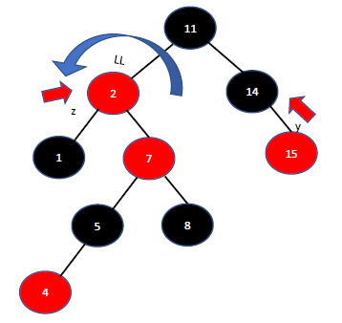
Red Black Tree
Insertion (Example 1):
Insert the following elements into an empty RB-Tree.
[ 11, 2, 14, 1, 7, 15, 5, 8, 4]
Insert -4

Slide 41
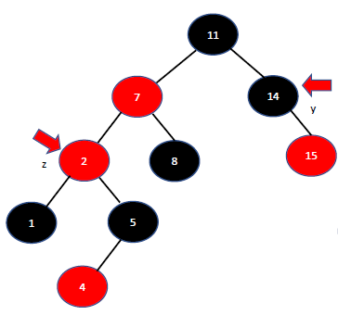

Red Black Tree
Insertion (Example 1):
Insert the following elements into an empty RB-Tree.
[ 11, 2, 14, 1, 7, 15, 5, 8, 4]
Insert -4

Slide 42
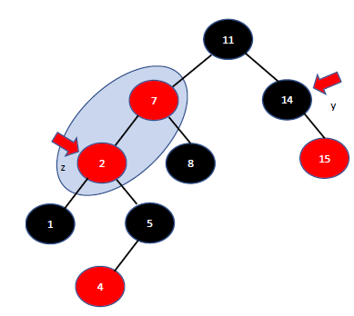
Red Black Tree
Insertion (Example 1):
Insert the following elements into an empty RB-Tree.
[ 11, 2, 14, 1, 7, 15, 5, 8, 4]
Insert -4

Slide 43
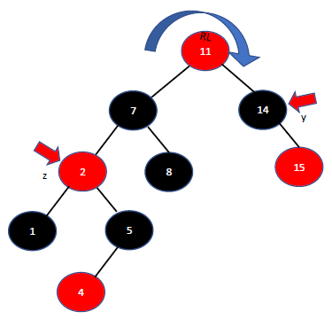

Red Black Tree
Insertion (Example 1):
Insert the following elements into an empty RB-Tree.
[ 11, 2, 14, 1, 7, 15, 5, 8, 4]
Insert -4

Slide 44
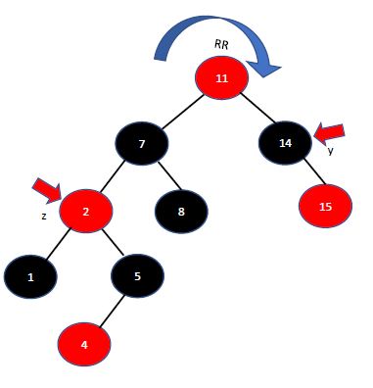

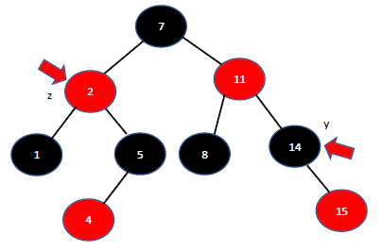
Red Black Tree
Insertion (Example 1):
Insert the following elements into an empty RB-Tree.
[ 11, 2, 14, 1, 7, 15, 5, 8, 4]
Insert -4

Slide 45
Red Black Tree
Insertion (Example 2):
Insert the following elements into an empty RB-Tree.
[ 50, 40, 30, 45, 20, 5]
Insert -50
50
Aply Fix up
z

Slide 46
Red Black Tree
Insertion (Example 2):
Insert the following elements into an empty RB-Tree.
[ 50, 40, 30, 45, 20, 5]
Insert -50
50
Apply Fix up
50
z

Slide 47
Red Black Tree
Insertion (Example 2):
Insert the following elements into an empty RB-Tree.
[ 50, 40, 30, 45, 20, 5]
Insert -50
50
Apply Fix up
50
z

Slide 48
Red Black Tree
No Fixup required
Insertion (Example 2):
Insert the following elements into an empty RB-Tree.
[ 50, 40, 30, 45, 20, 5]
Insert -40
50
No Fixup required
40
z

Slide 49
Red Black Tree
No Fixup required
Insertion (Example 2):
Insert the following elements into an empty RB-Tree.
[ 50, 40, 30, 45, 20, 5]
Insert -30
50
40
NIL
30
z

Slide 50
Red Black Tree
Insertion (Example 2):
Insert the following elements into an empty RB-Tree.
[ 50, 40, 30, 45, 20, 5]
Insert -30
RR
50
50
Case 3
Fixup Apply
40
NIL
40
NIL
y
y
30
30
40
After RR
Fixup Apply
z
30
50

Slide 51
Red Black Tree
Insertion (Example 2):
Insert the following elements into an empty RB-Tree.
[ 50, 40, 30, 45, 20, 5]
Insert -45
40
30
50
y
z
45

Slide 52
Red Black Tree
Insertion (Example 2):
Insert the following elements into an empty RB-Tree.
[ 50, 40, 30, 45, 20, 5]
Insert -45
40
30
50
y
z
45

Slide 53
Red Black Tree
Insertion (Example 2):
Insert the following elements into an empty RB-Tree.
[ 50, 40, 30, 45, 20, 5]
Insert -45
40
40
Case 1
Fixup Apply
30
50
30
50
y
y
z
45
z
45

Slide 54
Red Black Tree
Insertion (Example 2):
Insert the following elements into an empty RB-Tree.
[ 50, 40, 30, 45, 20, 5]
Insert -45
40
40
40
Case 1
Fixup Apply
Apply Fix up
30
50
30
50
30
50
y
y
y
45
45
z
45
z
z

Slide 55
Red Black Tree
Insertion (Example 2):
Insert the following elements into an empty RB-Tree.
[ 50, 40, 30, 45, 20, 5]
Insert -20
40
30
50
z
20
45

Slide 56
Red Black Tree
Insertion (Example 2):
Insert the following elements into an empty RB-Tree.
[ 50, 40, 30, 45, 20, 5]
Insert -20
40
30
50
No Fixup required
z
20
45

Slide 57
Red Black Tree
Insertion (Example 2):
Insert the following elements into an empty RB-Tree.
[ 50, 40, 30, 45, 20, 5]
Insert -5
40
30
50
20
45
20
z

Slide 58
Red Black Tree
Insertion (Example 2):
Insert the following elements into an empty RB-Tree.
[ 50, 40, 30, 45, 20, 5]
Insert -5
40
30
50
20
NIL
45
5
y
z

Slide 59
Red Black Tree
Insertion (Example 2):
Insert the following elements into an empty RB-Tree.
[ 50, 40, 30, 45, 20, 5]
Insert -5
40
40
Case 3
RR
Fixup Apply
30
50
30
50
20
NIL
45
20
NIL
45
After RR
Fixup Apply
5
y
5
y
40
z
z
20
50
5
30
45
z

Slide 60
Red Black Tree
Insertion (Example 2):
Insert the following elements into an empty RB-Tree.
[ 50, 40, 30, 45, 20, 5]
Insert -5
40
40
Case 3
RR
Fixup Apply
30
50
30
50
20
NIL
45
20
NIL
45
After RR
Fixup Apply
5
y
5
y
40
z
z
20
50
5
30
45
z

Slide 61
Red Black Tree
Insertion (Example 2):
Insert the following elements into an empty RB-Tree.
[ 50, 40, 30, 45, 20, 5]
Insert -5
40
40
Case 3
RR
Fixup Apply
30
50
30
50
20
NIL
45
20
NIL
45
After RR
Fixup Apply
5
y
5
y
40
z
z
20
50
5
30
45
z

Slide 62
Red Black Tree
Insertion (Example 2):
Insert the following elements into an empty RB-Tree.
[ 50, 40, 30, 45, 20, 5]
Insert -5
40
40
Case 3
RR
Fixup Apply
30
50
30
50
20
NIL
45
20
NIL
45
After RR
Fixup Apply
5
y
5
y
40
z
z
20
50
5
30
45
z

Slide 63
Red Black Tree
Insertion (Example 3):
Insert the following elements into an empty RB-Tree.
[ 41, 38, 31, 12, 19, 8]
Insert -50
41
z

Slide 64
Red Black Tree
Insertion (Example 3):
Insert the following elements into an empty RB-Tree.
[ 41, 38, 31, 12, 19, 8]
Insert -50
41
Aply Fix up
41
z
z

Slide 65
Red Black Tree
Insertion (Example 3):
Insert the following elements into an empty RB-Tree.
[ 41, 38, 31, 12, 19, 8]
Insert -38
41
38
z

Slide 66
Red Black Tree
Insertion (Example 3):
Insert the following elements into an empty RB-Tree.
[ 41, 38, 31, 12, 19, 8]
Insert -38
41
No Fixup required
38
z

Slide 67
Red Black Tree
Insertion (Example 3):
Insert the following elements into an empty RB-Tree.
[ 41, 38, 31, 12, 19, 8]
Insert -31
41
38
31
z

Slide 68
Red Black Tree
Insertion (Example 3):
Insert the following elements into an empty RB-Tree.
[ 41, 38, 31, 12, 19, 8]
Insert -31
41
38
NIL
31
y
z

Slide 69
Red Black Tree
Insertion (Example 3):
Insert the following elements into an empty RB-Tree.
[ 41, 38, 31, 12, 19, 8]
Insert -31
41
Case 3
38
NIL
Fixup Apply
31
y
z

Slide 70
Red Black Tree
Insertion (Example 3):
Insert the following elements into an empty RB-Tree.
[ 41, 38, 31, 12, 19, 8]
Insert -31
RR
41
41
Case 3
38
NIL
Fixup Apply
38
NIL
31
y
31
y
z
z

Slide 71
Red Black Tree
Insertion (Example 3):
Insert the following elements into an empty RB-Tree.
[ 41, 38, 31, 12, 19, 8]
Insert -31
RR
41
41
Case 3
After RR
Fixup Apply
38
NIL
Fixup Apply
38
NIL
31
y
31
y
z
z

Slide 72
Red Black Tree
Insertion (Example 3):
Insert the following elements into an empty RB-Tree.
[ 41, 38, 31, 12, 19, 8]
Insert -31
RR
41
38
41
Case 3
After RR
Fixup Apply
38
NIL
Fixup Apply
31
41
38
NIL
z
31
y
31
y
z
z

Slide 73
Red Black Tree
Insertion (Example 3):
Insert the following elements into an empty RB-Tree.
[ 41, 38, 31, 12, 19, 8]
Insert -12
38
31
41
12
z

Slide 74
Red Black Tree
Insertion (Example 3):
Insert the following elements into an empty RB-Tree.
[ 41, 38, 31, 12, 19, 8]
Insert -12
38
31
41
12
y
z

Slide 75
Red Black Tree
Insertion (Example 3):
Insert the following elements into an empty RB-Tree.
[ 41, 38, 31, 12, 19, 8]
Insert -12
38
Case 1
Fixup Apply
31
41
12
y
z

Slide 76
Red Black Tree
Insertion (Example 3):
Insert the following elements into an empty RB-Tree.
[ 41, 38, 31, 12, 19, 8]
Insert -12
38
z
38
Case 1
Fixup Apply
31
31
41
41
y
12
y
12
z

Slide 77
Red Black Tree
Insertion (Example 3):
Insert the following elements into an empty RB-Tree.
[ 41, 38, 31, 12, 19, 8]
Insert -19
38
31
41
12
19
z

Slide 78
Red Black Tree
Insertion (Example 3):
Insert the following elements into an empty RB-Tree.
[ 41, 38, 31, 12, 19, 8]
Insert -19
38
31
41
12
NIL
y
19
z

Slide 79
Red Black Tree
Insertion (Example 3):
Insert the following elements into an empty RB-Tree.
[ 41, 38, 31, 12, 19, 8]
Insert -19
38
38
Case 2
31
41
Fixup Apply
31
41
NIL
LL
12
12
NIL
z
y
y
19
19
z

Slide 80
Red Black Tree
Insertion (Example 3):
Insert the following elements into an empty RB-Tree.
[ 41, 38, 31, 12, 19, 8]
Insert -19
38
38
38
After LL
Case 2
Fixup Apply
31
41
31
41
Fixup Apply
31
41
NIL
LL
z
19
NIL
12
12
NIL
z
y
y
y
12
19
19
z

Slide 81
Red Black Tree
Insertion (Example 3):
Insert the following elements into an empty RB-Tree.
[ 41, 38, 31, 12, 19, 8]
Insert -19
38
38
RR
After LL
31
Case 3
Fixup Apply
41
Fixup Apply
31
41
19
NIL
19
NIL
z
y
z
y
12
12

Slide 82
Red Black Tree
Insertion (Example 3):
Insert the following elements into an empty RB-Tree.
[ 41, 38, 31, 12, 19, 8]
Insert -19
38
38
RR
After LL
31
Case 3
Fixup Apply
41
Fixup Apply
31
41
After RR
Fixup Apply
19
NIL
19
NIL
z
y
z
y
12
12

Slide 83
Red Black Tree
Insertion (Example 3):
Insert the following elements into an empty RB-Tree.
[ 41, 38, 31, 12, 19, 8]
Insert -19
38
38
RR
After LL
31
Case 3
Fixup Apply
41
Fixup Apply
31
41
After RR
Fixup Apply
19
NIL
19
NIL
z
38
y
z
y
12
12
19
41
z
12
31

Slide 84
Red Black Tree
Insertion (Example 3):
Insert the following elements into an empty RB-Tree.
[ 41, 38, 31, 12, 19, 8]
Insert -8
38
19
41
12
31
z
8

Slide 85
Red Black Tree
Insertion (Example 3):
Insert the following elements into an empty RB-Tree.
[ 41, 38, 31, 12, 19, 8]
Insert -8
38
19
41
12
31
z
y
8

Slide 86
Red Black Tree
Insertion (Example 3):
Insert the following elements into an empty RB-Tree.
[ 41, 38, 31, 12, 19, 8]
Insert -8
38
19
41
Case 1
Fixup Apply
12
31
z
y
8

Slide 87
Red Black Tree
Insertion (Example 3):
Insert the following elements into an empty RB-Tree.
[ 41, 38, 31, 12, 19, 8]
Insert -8
38
38
19
41
Case 1
19
41
Fixup Apply
12
31
12
31
z
z
8
y
y
8

Slide 88
Red Black Tree
Insertion (Example 4):
Insert the following elements into an empty RB-Tree.
[ 5, 10 ,15 , 25, 20 ,30]
Insert -5
5
z

Slide 89
Red Black Tree
Insertion (Example 4):
Insert the following elements into an empty RB-Tree.
[ 5, 10 ,15 , 25, 20 ,30]
Insert -5
5
Aply Fix up
5
z
z

Slide 90
Red Black Tree
Insertion (Example 4):
Insert the following elements into an empty RB-Tree.
[ 5, 10 ,15 , 25, 20 ,30]
Insert -10
5
10
z

Slide 91
Red Black Tree
Insertion (Example 4):
Insert the following elements into an empty RB-Tree.
[ 5, 10 ,15 , 25, 20 ,30]
Insert -10
5
No Fixup required
10
z

Slide 92
Red Black Tree
Insertion (Example 4):
Insert the following elements into an empty RB-Tree.
[ 5, 10 ,15 , 25, 20 ,30]
Insert -15
5
10
10
z

Slide 93
Red Black Tree
Insertion (Example 4):
Insert the following elements into an empty RB-Tree.
[ 5, 10 ,15 , 25, 20 ,30]
Insert -15
5
NIL
10
y
15
z

Slide 94
Red Black Tree
Insertion (Example 4):
Insert the following elements into an empty RB-Tree.
[ 5, 10 ,15 , 25, 20 ,30]
Insert -15
5
Case 3
Fixup Apply
NIL
10
y
15
z

Slide 95
Red Black Tree
Insertion (Example 4):
Insert the following elements into an empty RB-Tree.
[ 5, 10 ,15 , 25, 20 ,30]
Insert -15
5
10
Case 3
Fixup Apply
NIL
10
5
15
y
15
z
z

Slide 96
Red Black Tree
Insertion (Example 4):
Insert the following elements into an empty RB-Tree.
[ 5, 10 ,15 , 25, 20 ,30]
Insert -25
10
5
15
25
z

Slide 97
Red Black Tree
Insertion (Example 4):
Insert the following elements into an empty RB-Tree.
[ 5, 10 ,15 , 25, 20 ,30]
Insert -25
10
5
15
y
25
z

Slide 98
Red Black Tree
Insertion (Example 4):
Insert the following elements into an empty RB-Tree.
[ 5, 10 ,15 , 25, 20 ,30]
Insert -25
10
Case 1
5
15
Fixup Apply
y
25
z

Slide 99
Red Black Tree
Insertion (Example 4):
Insert the following elements into an empty RB-Tree.
[ 5, 10 ,15 , 25, 20 ,30]
Insert -25
10
10
Case 1
5
Fixup Apply
z
15
5
15
y
25
y
25
z

Slide 100
Red Black Tree
Insertion (Example 4):
Insert the following elements into an empty RB-Tree.
[ 5, 10 ,15 , 25, 20 ,30]
Insert -25
10
10
10
Case 1
z
5
Fixup Apply
z
Aply Fix up
15
5
5
15
15
y
25
y
y
25
25
z

Slide 101
Red Black Tree
Insertion (Example 4):
Insert the following elements into an empty RB-Tree.
[ 5, 10 ,15 , 25, 20 ,30]
Insert -20
10
5
15
25
20
z

Slide 102
Red Black Tree
Insertion (Example 4):
Insert the following elements into an empty RB-Tree.
[ 5, 10 ,15 , 25, 20 ,30]
Insert -20
10
5
15
NIL
25
y
20
z

Slide 103
Red Black Tree
Insertion (Example 4):
Insert the following elements into an empty RB-Tree.
[ 5, 10 ,15 , 25, 20 ,30]
Insert -20
10
Case 2
5
Fixup Apply
15
NIL
25
y
20
z

Slide 104
Red Black Tree
Insertion (Example 4):
Insert the following elements into an empty RB-Tree.
[ 5, 10 ,15 , 25, 20 ,30]
Insert -20
10
10
Case 2
5
5
Fixup Apply
15
15
RR
NIL
25
NIL
25
y
z
y
20
20
z

Slide 105
Red Black Tree
Insertion (Example 4):
Insert the following elements into an empty RB-Tree.
[ 5, 10 ,15 , 25, 20 ,30]
Insert -20
10
10
10
After RR
Fixup Apply
Case 2
5
5
Fixup Apply
15
5
15
15
RR
NIL
25
NIL
NIL
25
20
y
z
y
y
20
25
20
z
z

Slide 106
Red Black Tree
Insertion (Example 4):
Insert the following elements into an empty RB-Tree.
[ 5, 10 ,15 , 25, 20 ,30]
Insert -20
After RR
10
Fixup Apply
5
15
NIL
20
y
25
z

Slide 107
Red Black Tree
Insertion (Example 4):
Insert the following elements into an empty RB-Tree.
[ 5, 10 ,15 , 25, 20 ,30]
Insert -20
After RR
10
Fixup Apply
5
15
NIL
20
y
25
z

Slide 108
Red Black Tree
Insertion (Example 4):
Insert the following elements into an empty RB-Tree.
[ 5, 10 ,15 , 25, 20 ,30]
Insert -20
After RR
10
Fixup Apply
Case 3
Fixup Apply
5
15
NIL
20
y
25
z

Slide 109
Red Black Tree
Insertion (Example 4):
Insert the following elements into an empty RB-Tree.
[ 5, 10 ,15 , 25, 20 ,30]
Insert -20
10
After RR
10
Case 3
Fixup Apply
Fixup Apply
LL
5
15
5
15
NIL
20
NIL
20
y
25
y
25
z
z

Slide 110
Red Black Tree
Insertion (Example 4):
Insert the following elements into an empty RB-Tree.
[ 5, 10 ,15 , 25, 20 ,30]
Insert -20
10
10
Case 3
After LL
After RR
10
Fixup Apply
Fixup Apply
Fixup Apply
LL
5
15
5
20
5
15
NIL
20
15
25
NIL
20
y
y
z
25
y
25
z
z

Slide 111
Red Black Tree
Insertion (Example 4):
Insert the following elements into an empty RB-Tree.
[ 5, 10 ,15 , 25, 20 ,30]
Insert -30
10
5
20
15
25
y
30
z

Slide 112
Red Black Tree
Insertion (Example 4):
Insert the following elements into an empty RB-Tree.
[ 5, 10 ,15 , 25, 20 ,30]
Insert -30
10
5
20
15
25
y
30
z

Slide 113
Red Black Tree
Insertion (Example 4):
Insert the following elements into an empty RB-Tree.
[ 5, 10 ,15 , 25, 20 ,30]
Insert -30
10
Case 1
Fixup Apply
5
20
15
25
y
30
z

Slide 114
Red Black Tree
Insertion (Example 4):
Insert the following elements into an empty RB-Tree.
[ 5, 10 ,15 , 25, 20 ,30]
Insert -30
10
10
Case 1
Fixup Apply
5
20
5
20
15
15
z
25
25
y
y
30
30
z

Slide 115

Thank U

